Slide 1

Vel Tech Rangarajan Dr. Sagunthala R&D Institute of Science and Technology
School of Computing
Department of Computer Science and Engineering
10211CS224 / FULL STACK APPLICATION DEVELOPMENT (JAVA)
PROJECT REVIEW : MILESTONE FINAL PROJECT
Date: 06-05-2026
Smart Campus Event Management System
SDG : SDG 4 – Quality Education and SDG 8 – Decent Work and Economic Growth
Presented By:
P PAVAN KMAR- VTU26778 – Reg.No.23UECS0453
Courses Handling Faculty:
Dr. Hemamalini.S

Slide 2
INTRODUCTION
The Smart Campus Event Management System is a web-based application designed to manage and organize campus events efficiently.
It provides a centralized platform for students, publishers, and hosts to interact and manage event-related activities.
Students can easily browse upcoming events, register online, and track their participation.
Event publishers can create, update, and manage event details in a structured way.
Hosts (administrators) can monitor the system, approve events, and analyze participation data.
The system is built using modern full-stack technologies like Spring Boot and JPA ORM for efficient data handling.
It follows a secure and scalable architecture with role-based access control.
The application features a clean, nature-inspired user interface for better user experience.
1
2
3
4
5
6
7
8
9

Slide 3
PROBLEM STATEMENT
Managing campus events through manual or scattered systems leads to inefficiencies and confusion among students and organizers. There is often no centralized platform where students can easily discover upcoming events and register for them. Event organizers face difficulties in creating, updating, and promoting events effectively. Communication gaps between students and organizers result in low participation and missed opportunities. Existing systems lack proper role-based access, making it hard to control and manage different user responsibilities. Additionally, tracking registrations and maintaining event data manually is time-consuming and error-prone. There is also a lack of real-time updates and analytics to monitor event performance. Security concerns arise due to improper handling of user data and authentication. Without a structured system, duplication of data and mismanagement of event schedules occur frequently. Therefore, there is a need for a centralized, secure, and efficient web-based solution to manage campus events effectively.
1
2
3
4
5
6
7
8
9

Slide 4
OBJECTIVE(S)
The primary objective of this project is to develop a centralized web-based platform for managing campus events efficiently. It aims to simplify the process of event creation, browsing, and registration for students and organizers. The system ensures smooth coordination between users by providing real-time access to event information. It also focuses on improving user experience through a clean and intuitive interface.
Another objective is to implement a secure and scalable system using Spring Boot and JPA ORM for efficient data management. The project emphasizes role-based access control to manage different user responsibilities effectively. It aims to reduce manual effort and errors by automating event handling processes. Additionally, the system seeks to provide insights and analytics to enhance decision-making and event planning.
1
2
3
4
5
6
7
8
9

Slide 5
PROPOSED SYSTEM
Develop a centralized web-based application to manage all campus events in one platform.
Provide role-based access control with three roles: User (Student), Publisher, and Host (Admin).
Enable students to browse, search, and register for events بسهولة and track their participation.
Allow publishers to create, update, and manage event details through a structured interface.
Implement an approval system where hosts can approve or reject events created by publishers.
Use Spring Boot with Spring Data JPA (ORM) for efficient data handling and database interaction.
Incorporate secure authentication and authorization using Spring Security.
Provide analytics and reports for hosts to monitor event registrations and overall system performance.
1
2
3
4
5
6
7
8
9

Slide 6
PROPOSED SYSTEM ARCHITECTURE
1
2
3
4
5
6
7
8
9

Slide 7
WORKFLOW
1
2
3
4
5
6
7
8
9

Slide 8
TECHNOLOGIES USED
Technologies Used :
Frontend:
HTML, CSS, and Thymeleaf are used to build a responsive UI with dynamic content rendering.
Backend:
Spring Boot (Java) handles business logic, APIs, and secure role-based authentication.
Database:
MySQL stores data, while Spring Data JPA (ORM) manages database operations efficiently.
Tools & Environment:
VS Code/IntelliJ, Maven, MySQL Workbench, and Chrome are used for development and testing.
Hardware/Software Requirements:
Requires a system with 4GB RAM, JDK 17+, MySQL, and a modern web browser.
1
2
3
4
5
6
7
8
9

Slide 9
MODULE DESCRIPTION
Module 1: User Management
Handles user registration, login, and logout with secure authentication using Spring Security. It manages role-based access for User (Student), Publisher, and Host, ensuring controlled access to different functionalities.
Module 2: Event Management
Manages creation, updating, deletion, and approval of events using CRUD operations. Publishers can add and modify events, while Hosts can approve, reject, or manage all events in the system.
Module 3: Event Registration System
Allows users to register and unregister for events dynamically. It maintains registration records in the database and ensures proper mapping between users and events using JPA relationships.
Module 4: Backend & Database Processing
Handles server-side logic, API routing, and database operations using Spring Boot and MySQL. Spring Data JPA (ORM) ensures efficient data mapping, validation, and retrieval of users, events, and registrations.
1
2
3
4
5
6
7
8
9

Slide 10
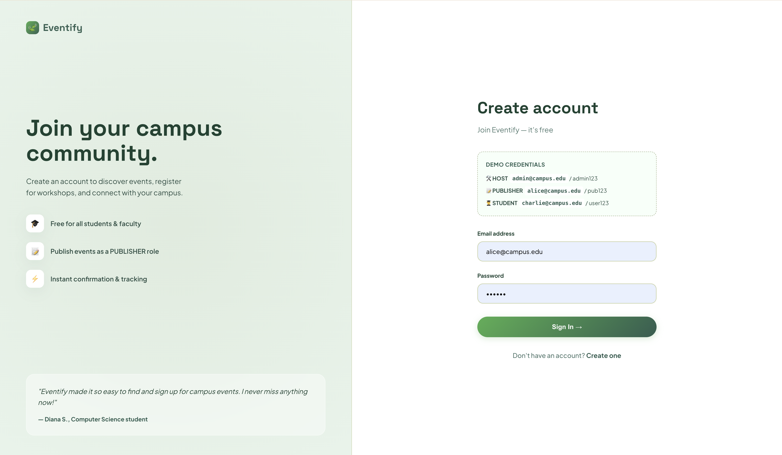
IMPLEMENTATION SCREENSHOTS
LOGIN PAGE :
1
2
3
4
5
6
7
8
9

Slide 11

IMPLEMENTATION SCREENSHOTS
HOME PAGE :
1
2
3
4
5
6
7
8
9

Slide 12
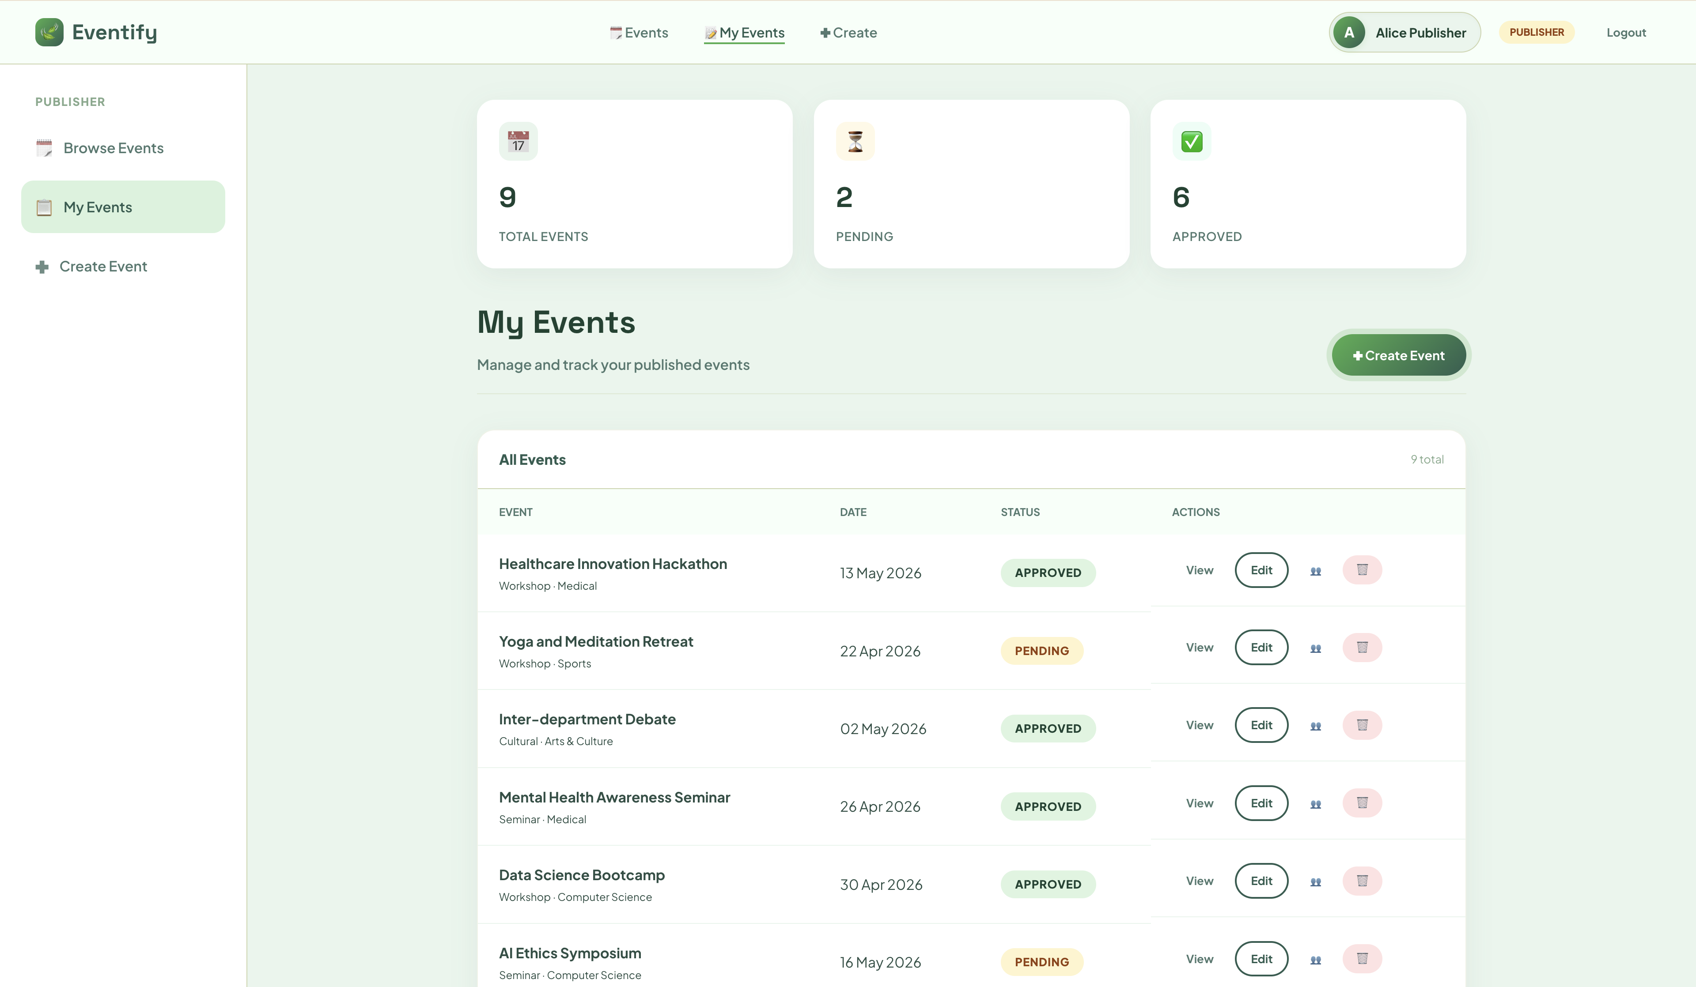
IMPLEMENTATION SCREENSHOTS
ADMIN PAGE :
1
2
3
4
5
6
7
8(A)
9

Slide 13
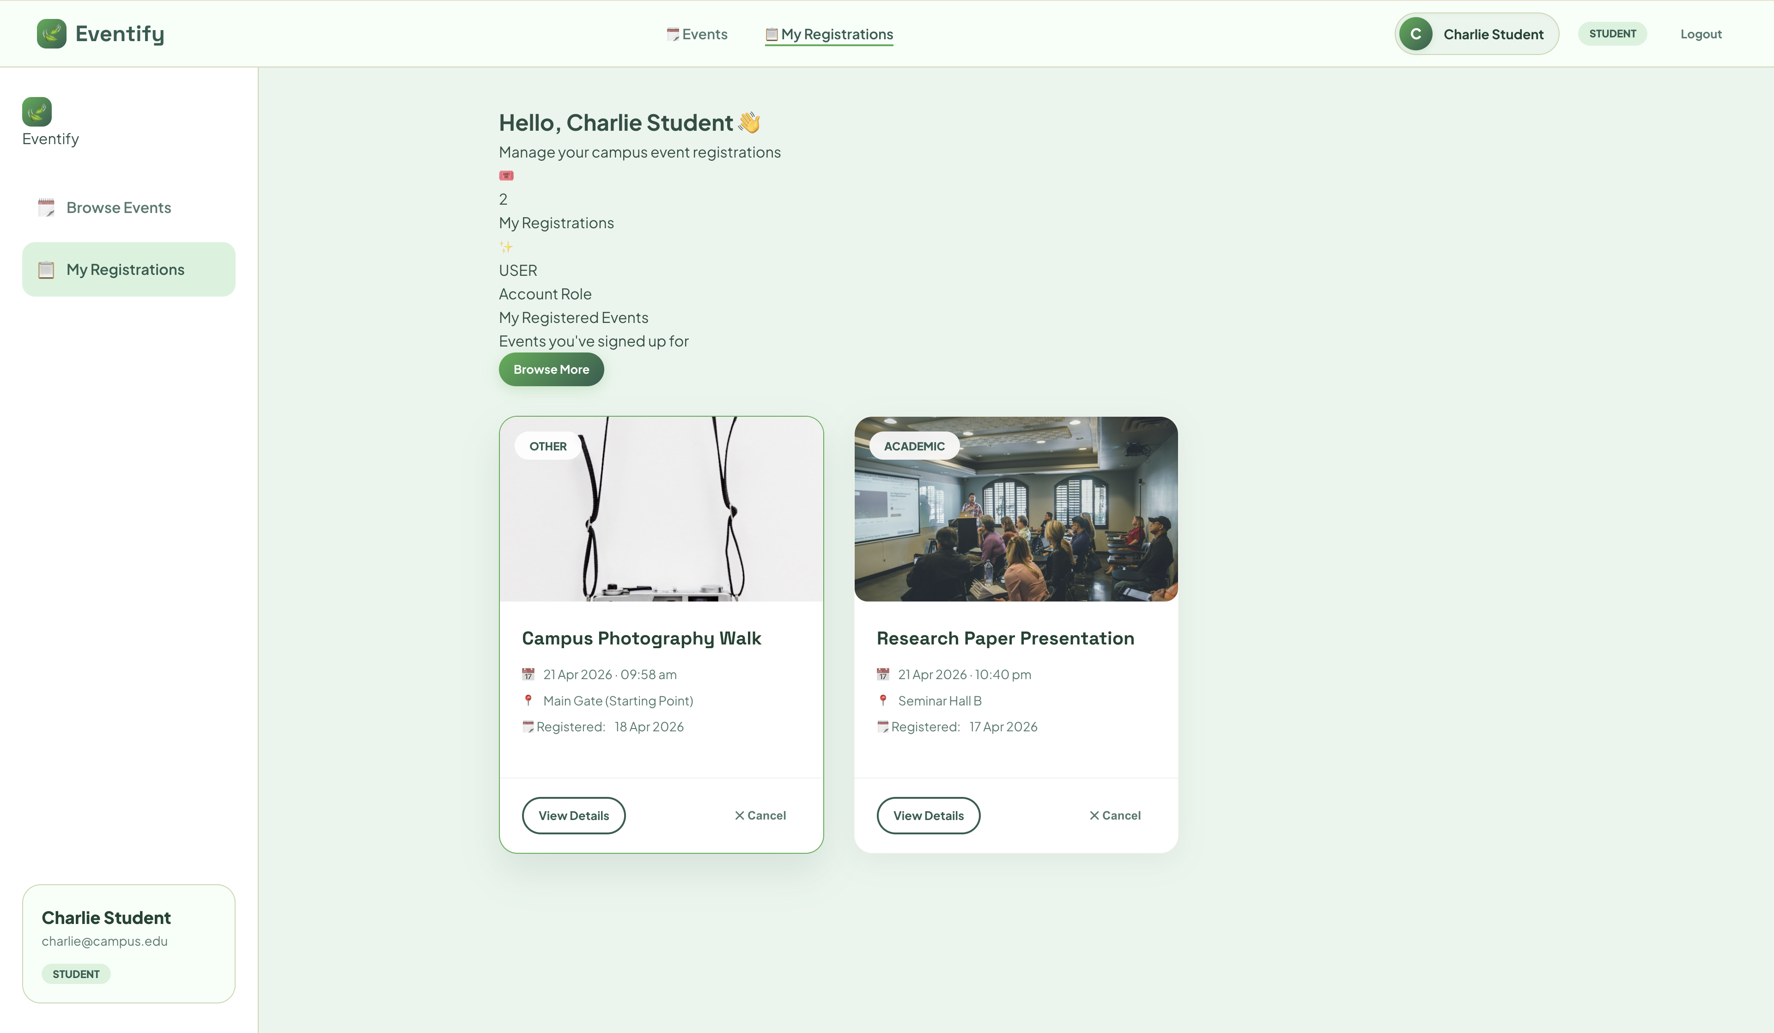
IMPLEMENTATION SCREENSHOTS
STUDENT PORTAL PAGE :
1
2
3
4
5
6
7
8(B)
9

Slide 14
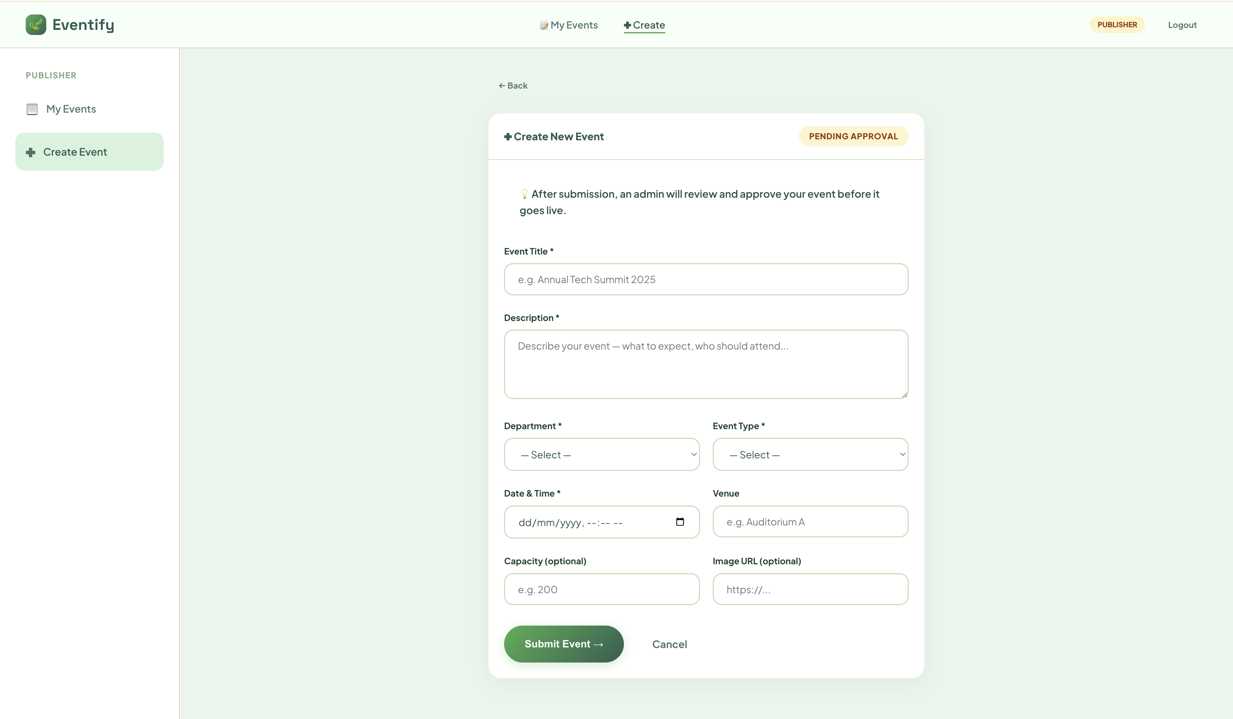
IMPLEMENTATION SCREENSHOTS
EVENT CREATION PAGE :
1
2
3
4
5
6
7
8(C)
9

Slide 15
ADVANTAGES & LIMITATIONS
Advantages
Secure role-based authentication system
Centralized event management platform
Dynamic and real-time event updates
Scalable and modular architecture
User-friendly and intuitive interface
Efficient data handling using JPA (ORM)
Supports role-based access (User, Publisher, Host)
Reduces manual effort and errors in event management
1
2
3
4
5
6
Limitations
Requires continuous internet connectivity
Limited to basic authentication (can be enhanced further)
No advanced notification system (email/SMS)
Basic UI customization options
Limited scalability without cloud deployment
No payment integration (if not implemented)
Requires further security hardening for production use
Dependent on proper database configuration
7
8
9

Slide 16
Thank you

